Slide 1
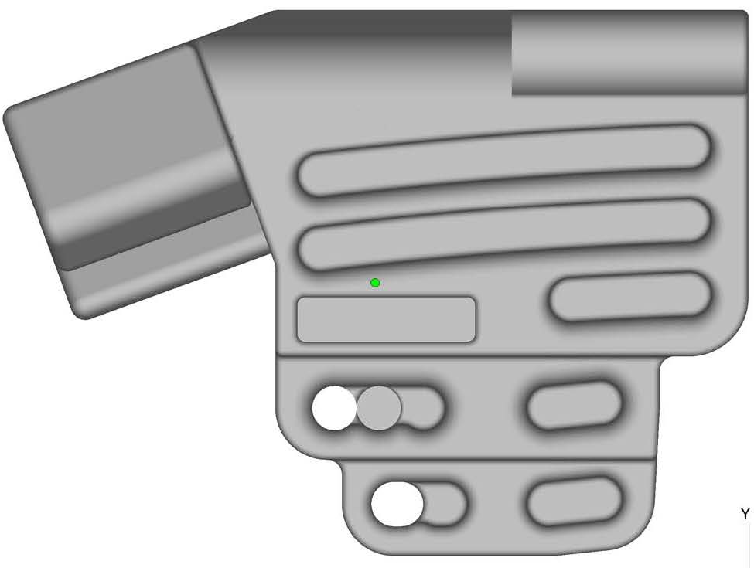
Sloper
Jug
L VDER
S VDER
Wide
Pinch
Med Pinch
3F Slot
Thin Crimp
IM (deep)
1
2
3
MR (deep)
IM (Med)
4
5
MR (shallow)
IM (shallow)

Slide 2
Position 0

Slide 3
Position 2

Slide 4
Position 1

